Slide 1

The miracle of nature.
On a street near you.
The Urban Nature Project
Schools Information Pack 2024

Slide 2
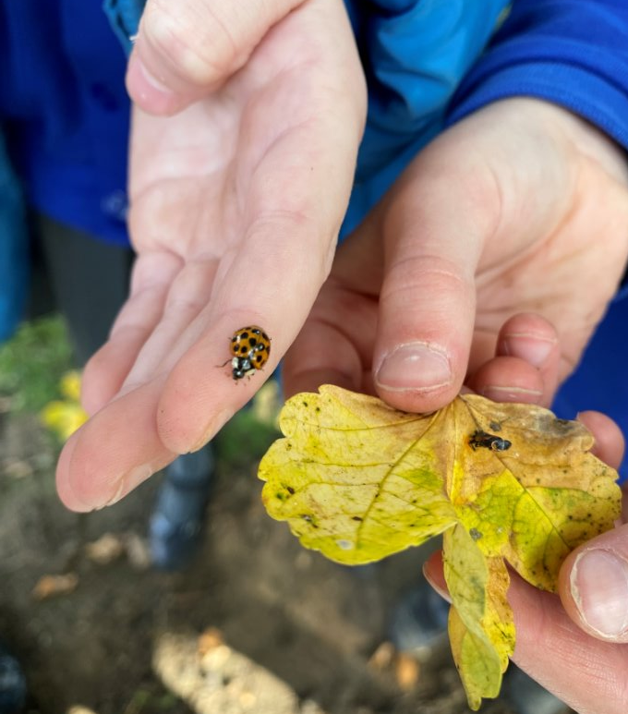
Join this national project
Get your pupils active in surveying and celebrating urban nature near you.
Explore how 'green' your school grounds really are, in a pupil-led investigation.
Choose one of two pathways
  Staff CPD and Outreach to support you and your pupils in investigating your school grounds.
  Be supported towards a mini exhibition of your own in the museum, including a launch visit, resources to borrow for work back at school, then a visit to install your display.

Slide 3
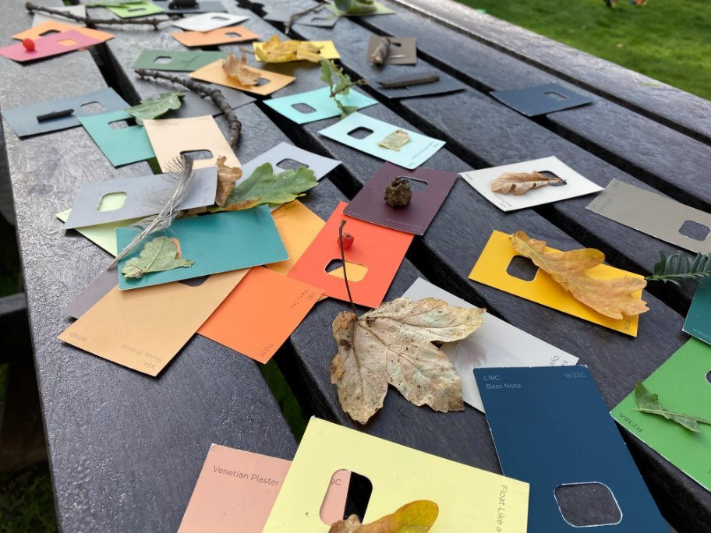
Project timelines
CPD & OuTREACH Pathway
Wave 2 dates
May
Monday 3 June
Activity
Teacher CPD
Outreach visit to school to support surveying

Slide 4
Project timelines
Exhibition Pathway
Wave 2 dates
Thursday 23 May
Wave 3 dates
24 May – 6 June
10 June – 8 July
10 June
Monday 17 June
18 June – 12 July
15 July
15 July - 31 August
Activity
Launch the project with a Great North Museum: Hancock visit
Activities to do back at school
Surveying and mapping
Creating urban nature art installations
Resources on loan from us
Second visit to Great North Museum: Hancock to install your mini exhibition
Your mini exhibition is on display to the public
  Teacher CPD can be requested as part of this pathway, dependent on staff availability for mutually convenient dates.

Slide 5
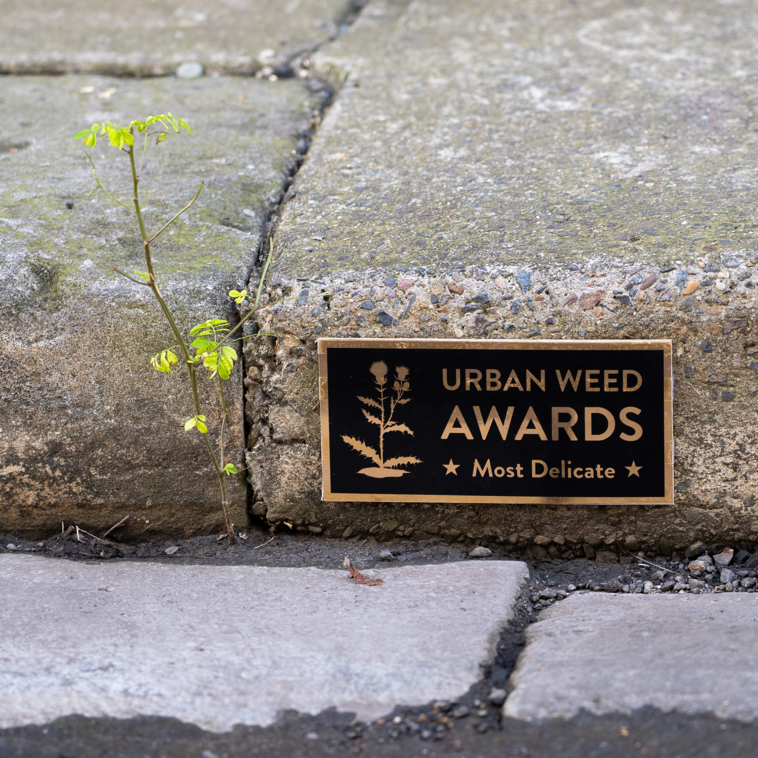
Exhibition information
Use surveying and classification resources to investigate how green your school grounds and/or local area are.
  Supported by various resources: including classification keys, bug pots, quadrats, sweep nets.
Practice mapping skills by considering what is missing about urban nature from typical street maps and OS maps.
  Annotate maps with acetates to show where urban nature is.
  This can be differentiated to various levels - for example noting down a good place for a minibeast hunt, to using surveying results to map the distribution of insects.
Get creative and make mini art installations in the style of Sydney's Michael Pederson
  Resources provided e.g. pre-made signs, panels and markers to make your own, miniature people, objects and signs.

Slide 6
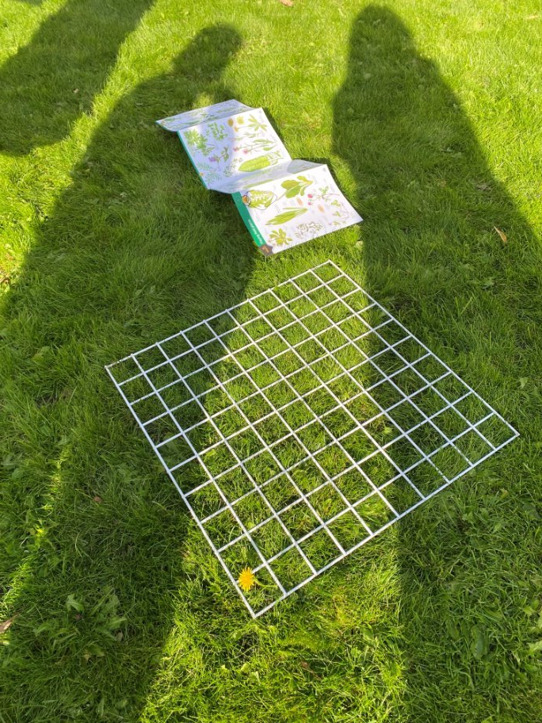
National Curriculum links
 | Key Stage 2 | Key Stage 3
Science | Working scientifically Plants Classification (within Living things) | Working scientifically Interactions and interdependencies
Geography | Geographical skills and fieldwork | Geographical skills and fieldwork
Maths | Statistics Area Percentages | Working mathematically Statistics
English | Spoken language
Citizenship | Preparing to be an active citizen

Slide 7
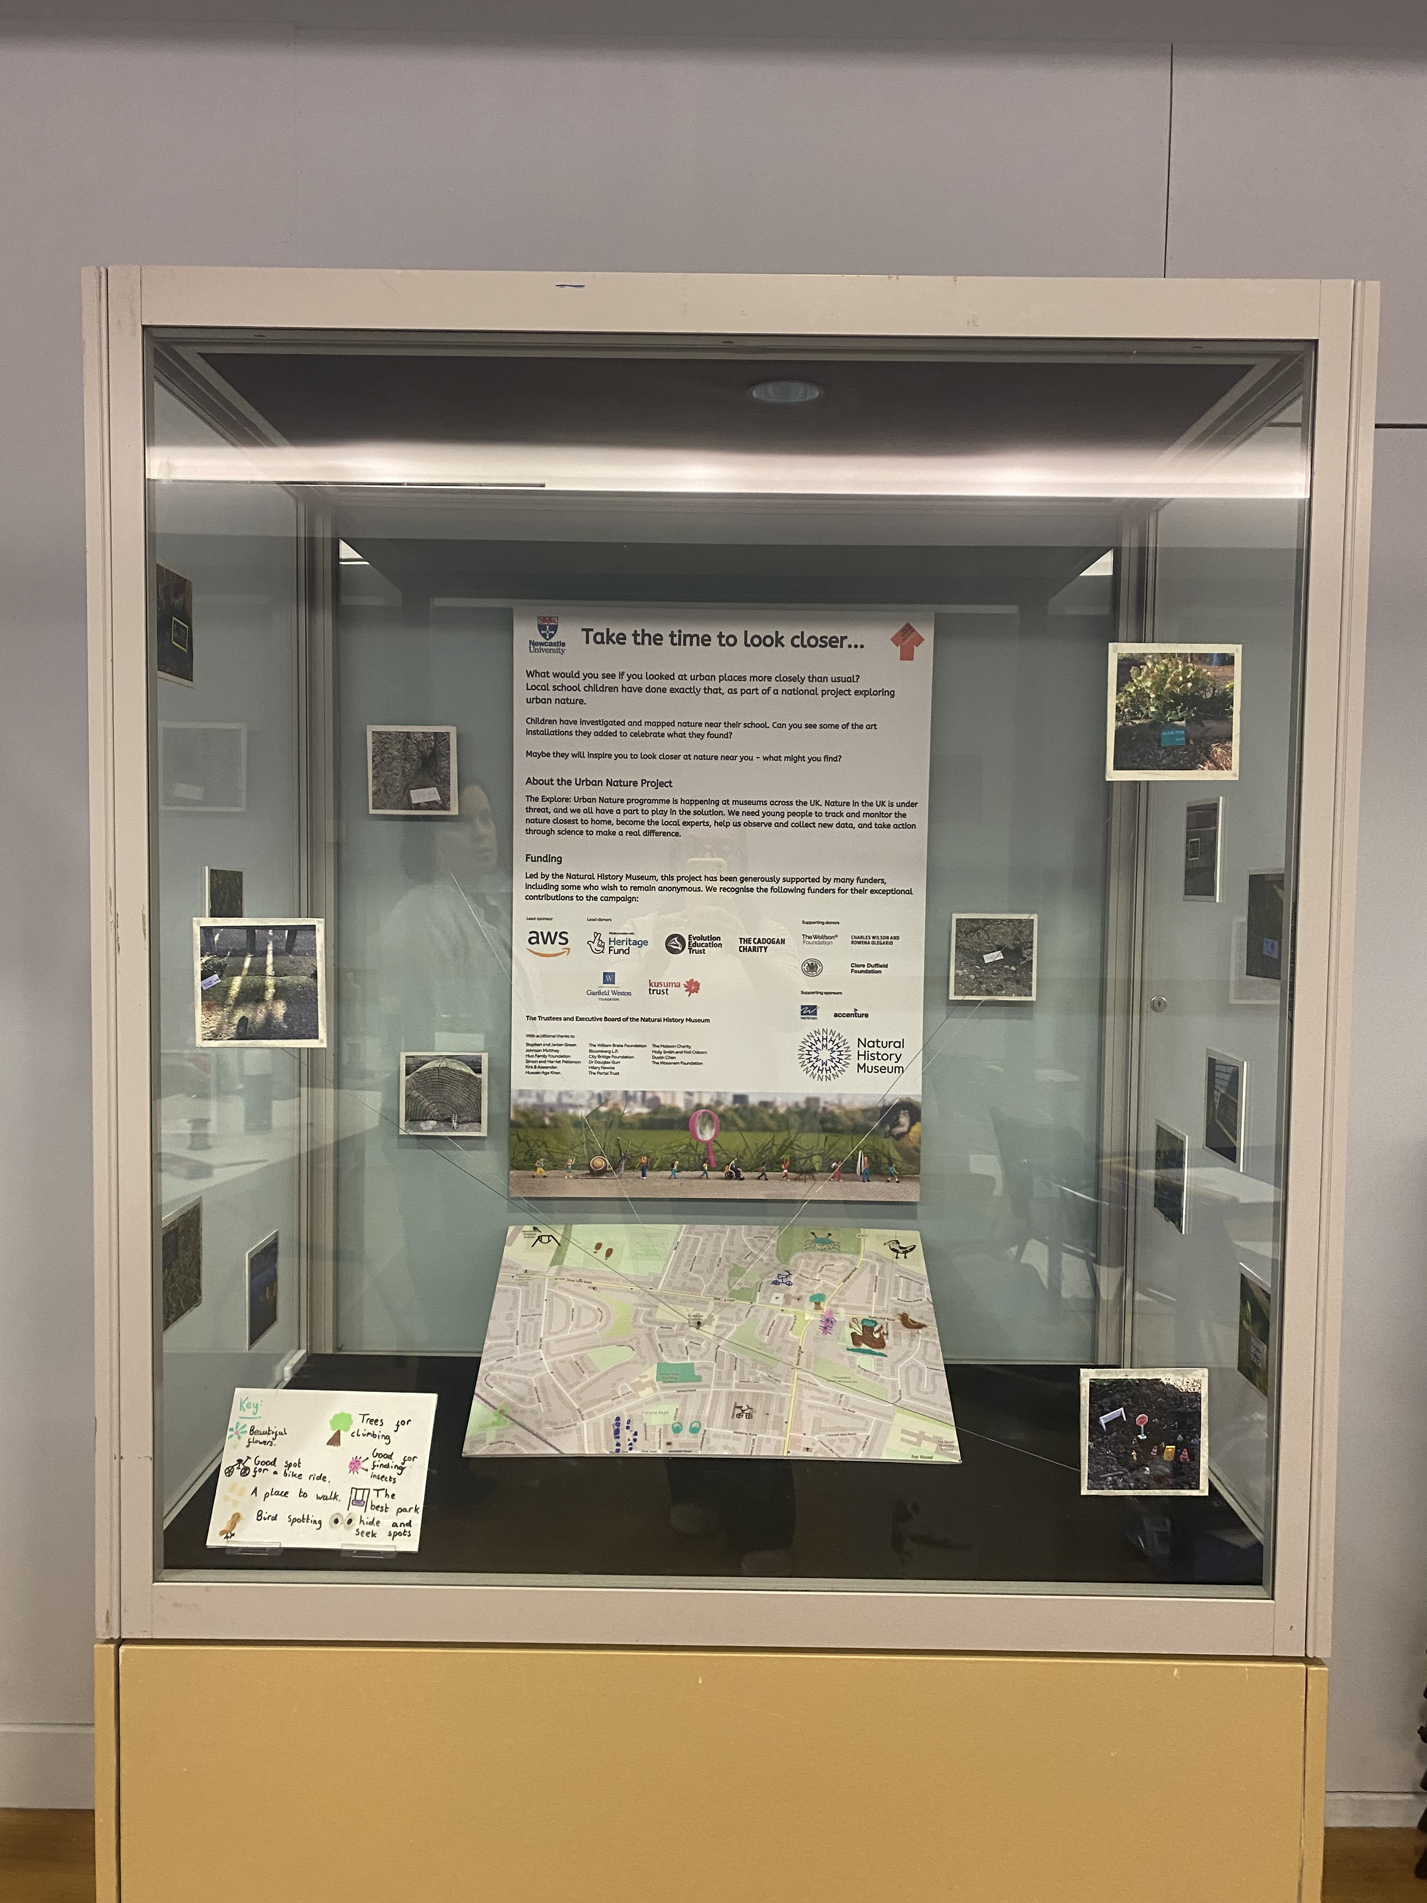
What might your exhibition look like?

Slide 8



